Slide 1
Exploratory Data Analysis for Clinical Research
February 4th, 2026 Emily Griffith
John Slankas
Notes:
Graphical representation of information and data
See and understand trends, outliers, and patterns in data

Slide 2
Outline
Welcome and introduction
Foundations
The EDA Lifecycle
Interpretation and next steps
Wrap up and Q&A
E
E

Slide 3
Welcome!
Who we are:
Emily Griffith Professor of the Practice, Department of Statistics Director of Consulting, Data Science and AI Academy, NC State
John Slankas Senior Research Scholar, Laboratory for Analytic Sciences, NC State
We manage a subaward from NC TraCS to help provide support for clinical research using data science techniques.
E,J
E

Slide 4
A quick note
We will discuss
EDA requirements for different types of analytical questions
The four dimensions of exploration
Data quality issues and limitations
Determining appropriate next steps after an EDA
We will provide
A synthetic dataset of respiratory patient records from OMOP CDM
A notebook with workshop exercises
We will post solutions to these exercises on our website!
E
E

Slide 5
Extras for you!
We have a website with:
a sample data set
sample exercises
solutions videos
E
E
Notes:
Website, data set, exercise workbooks

Slide 6
Exploratory Data Analysis Lifecycle
Comparative
Distributional
Next Steps:
Communication
Clarify Question
Understand and Validate Data
Exploration
Interpret Findings and Refine Hypothesis
Determine Next Steps
Modeling
Data / Process Redesign
Structural
Relational
Refinement
J
Notes:
This also differs when you have a planned study - in that case, you’ve already done these first two stages.

Slide 7
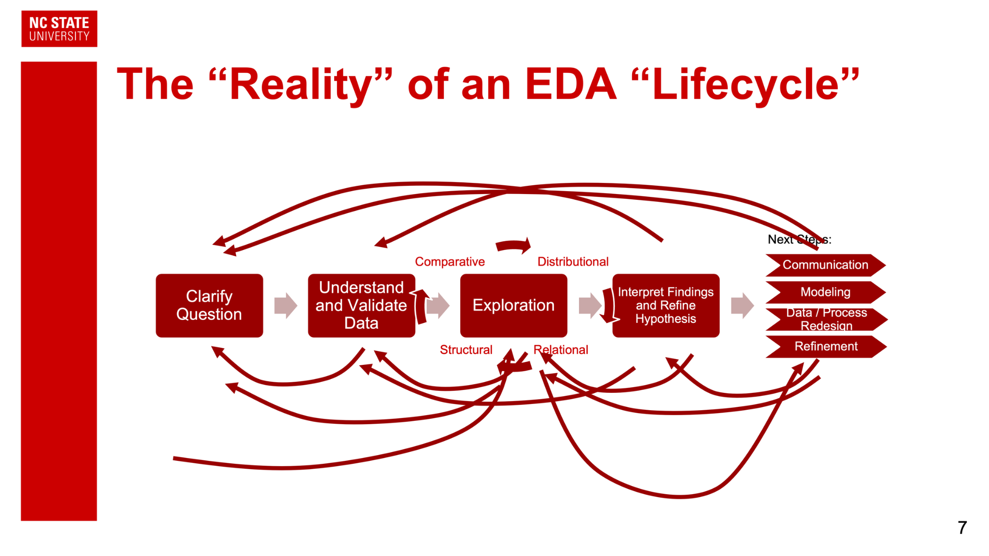
The “Reality” of an EDA “Lifecycle”
Comparative
Distributional
Next Steps:
Communication
Clarify Question
Understand and Validate Data
Exploration
Interpret Findings and Refine Hypothesis
Determine Next Steps
Modeling
Data / Process Redesign
Structural
Relational
Refinement
J
Notes:
Real life isn’t neat, Things will jump around … ideally, not forward

Slide 8
Stage One: Clarify Question
Comparative
Distributional
Next Steps:
Communication
Clarify Question
Understand and Validate Data
Exploration
Interpret Findings and Refine Hypothesis
Determine Next Steps
Modeling
Data / Process Redesign
Structural
Relational
Refinement
Descriptive: What happened?
Exploratory: What patterns exist?
Inferential: Does this generalize beyond the sample?
Predictive: What is likely to happen next?
Prescriptive: What action should we take?
Causal: What would happen if we intervened?
Mechanistic: What underlying process produces the behavior?
J

Slide 9
Stage One: Clarify Question
Comparative
Distributional
Next Steps:
Communication
Clarify Question
Understand and Validate Data
Exploration
Interpret Findings and Refine Hypothesis
Determine Next Steps
Modeling
Data / Process Redesign
Structural
Relational
Refinement
Descriptive: What happened?
Exploratory: What patterns exist?
Inferential: Does this generalize beyond the sample?
Predictive: What is likely to happen next?
Prescriptive: What action should we take?
Causal: What would happen if we intervened?
Mechanistic: What underlying process produces the behavior?
What counts as relevant evidence?
What assumptions are present?
What can be concluded?
J

Slide 10
Stage One: Descriptive Questions
Comparative
Distributional
Next Steps:
Communication
Clarify Question
Understand and Validate Data
Exploration
Interpret Findings and Refine Hypothesis
Determine Next Steps
Modeling
Data / Process Redesign
Structural
Relational
Refinement
Descriptive: What happened?
Summarize events, conditions, or behavior as recorded in the data.
Provide clear, accurate reporting
No claims of generality or forecasting.
What is the distribution of respiratory conditions (e.g., pneumonia, cough, dyspnea) across all patient visits?
What are the mean, median, and range of vital signs (oxygen saturation, respiratory rate, heart rate) for suspected COVID-19 patients?
How many inpatient vs. outpatient visits occurred, and what is the average length of stay for inpatient visits?
J
Notes:
Descriptive analysis is about faithful reporting, not interpretation.
What counts as relevant evidence? well-defined variables, completeness, consistency
Accurate counts, summaries, and visualizations
Clear definitions of variables and populations
Complete reporting of what is observed in the data
What assumptions are present?
Data accurately reflects recorded events
Coding and measurements are internally consistent
No assumption of representativeness or causality
What can be concluded?
What happened in this dataset
What was observed, measured, or recorded
Nothing about prediction, causes, or generalization

Slide 11
Stage One: Exploratory Questions
Comparative
Distributional
Next Steps:
Communication
Clarify Question
Understand and Validate Data
Exploration
Interpret Findings and Refine Hypothesis
Determine Next Steps
Modeling
Data / Process Redesign
Structural
Relational
Refinement
Exploratory: What patterns and relationships exist?
Search for structure, trends, anomalies, or relationships
Gain insights or guide further analysis.
Goal: hypothesis generation rather than confirmation.
Is there a relationship between body temperature and oxygen saturation levels in suspected COVID-19 patients?
Do patients with multiple respiratory conditions (e.g., pneumonia AND dyspnea) show different vital sign patterns than those with single conditions?
J
Notes:
Exploratory analysis generates questions — it does not answer them.
What counts as relevant evidence? enough observations to reveal patterns
Visual patterns (scatterplots, trends, clusters)
Consistency across multiple views
Identification of anomalies or subgroups
What assumptions are present?
Patterns are not purely artifacts of data structure
Measurement processes are reasonably stable
Relationships may be noisy or indirect
What can be concluded?
Patterns suggest hypotheses
Certain relationships are worth deeper study
Nothing is confirmed or validated

Slide 12
Stage One: Inferential Questions
Comparative
Distributional
Next Steps:
Communication
Clarify Question
Understand and Validate Data
Exploration
Interpret Findings and Refine Hypothesis
Determine Next Steps
Modeling
Data / Process Redesign
Structural
Relational
Refinement
Inferential: Does this generalize beyond the sample?
Representative of the population, not just the sample
Requires statistical assumptions and careful design
Can we infer that older patients have significantly higher rates of inpatient admission for respiratory conditions?
Is the mean respiratory rate significantly different between patients with pneumonia vs. those without?
J
Notes:
Inference is only as strong as the assumptions you can defend. What counts as relevant evidence? clear group definitions. Adequate sample sizes
Group comparisons with uncertainty estimates
Statistical summaries tied to assumptions
Adequate sample size and variability
What assumptions are present?
Sample represents a broader population
Observations are independent (often violated!)
Measurement error is random, not systematic
What can be concluded?
Whether observed differences are unlikely due to chance
Statements about populations under assumptions
Not clinical causation or policy decisions

Slide 13
Stage One: Predictive Questions
Comparative
Distributional
Next Steps:
Communication
Clarify Question
Understand and Validate Data
Exploration
Interpret Findings and Refine Hypothesis
Determine Next Steps
Modeling
Data / Process Redesign
Structural
Relational
Refinement
Predictive: What is likely to happen next?
Estimate unknown or future outcomes using existing data
Typically evaluated using an accuracy-based metric
Based on vital signs at admission, can we predict which patients will require inpatient care?
Based on historical visit patterns, can we predict which patients are likely to have recurring respiratory visits?
J
Notes:
Primarily focused on accuracy
What counts as relevant evidence? clearly defined outcomes, predictors available before the outcome
Historical features linked to future outcomes
Predictive performance metrics (accuracy, AUC)
Validation on unseen data
What assumptions are present?
Past patterns will persist into the future
Predictors are available at prediction time
Outcome labels are meaningful and reliable
What can be concluded?
How well the model predicts under similar conditions
Which features are informative for prediction
Not why outcomes occur

Slide 14
Stage One: Prescriptive Questions
Comparative
Distributional
Next Steps:
Communication
Clarify Question
Understand and Validate Data
Exploration
Interpret Findings and Refine Hypothesis
Determine Next Steps
Modeling
Data / Process Redesign
Structural
Relational
Refinement
Prescriptive: What action should we take?
Select the best action given
Costs
Benefits
Constraints
Risk tolerances
Which combination of vital sign thresholds should trigger escalation to inpatient care for respiratory patients?
Based on patient profiles, which demographic groups should be prioritized for flu vaccination outreach?
E
Notes:
requires a decision framework that incorporates financial impacts, operational rules, regulatory limits, and fairness constraints. Good predictions are necessary but not sufficient.
What counts as relevant evidence? - need additional data that’s not really present in this dataset
Predictive outputs combined with cost, risk, and benefit
Operational constraints and clinical priorities
Comparative evaluation of alternative actions
What assumptions are present?
Predictions are reliable enough to act on
Costs and benefits are understood and acceptable
Actions based on predictions will change outcomes
What can be concluded?
What actions might be preferred under stated assumptions
Trade-offs between competing objectives
Not guaranteed improvement

Slide 15
Stage One: Causal Questions
Comparative
Distributional
Next Steps:
Communication
Clarify Question
Understand and Validate Data
Exploration
Interpret Findings and Refine Hypothesis
Determine Next Steps
Modeling
Data / Process Redesign
Structural
Relational
Refinement
Causal: What would happen if we intervened?
Estimate the effect of a deliberate change/treatment
Data must support causal inference
Would earlier flu vaccination reduce the incidence of severe respiratory conditions requiring hospitalization?
Would applying treatment x for patients with abnormal respiratory rates at first presentation prevent disease progression?
E
Notes:
What counts as relevant evidence? Explicit intervention indicators
Explicit interventions and timing
Control for confounding factors
Process-level or workflow information
What assumptions are present?
No unmeasured confounding
Correct temporal ordering
Stable treatment and measurement processes
What can be concluded?
Very little from EDA alone
Whether causal claims are plausible
What additional data or design is required

Slide 16
Stage One: Mechanistic Questions
Comparative
Distributional
Next Steps:
Communication
Clarify Question
Understand and Validate Data
Exploration
Interpret Findings and Refine Hypothesis
Determine Next Steps
Modeling
Data / Process Redesign
Structural
Relational
Refinement
Mechanistic: What process produces this behavior?
Seek to understand how and why a system behaves the way it does
How do hospital admission criteria and triage protocols explain the observed patterns of inpatient vs. outpatient classification for similar presenting symptoms?
What standard clinical workflows or care pathways explain why certain respiratory conditions consistently receive more complete vital sign documentation than others?
E
Notes:
Pr

Slide 17
Stage Two: Understanding Data
Comparative
Distributional
Next Steps:
Communication
Clarify Question
Understand and Validate Data
Exploration
Interpret Findings and Refine Hypothesis
Determine Next Steps
Modeling
Data / Process Redesign
Structural
Relational
Refinement
Key Questions:
What kinds of data are we actually working with?
What does a single “row” represent in this dataset?
How are clinical concepts encoded and standardized?
What structure exists across time and hierarchy?
What data quality or representation issues should we expect?
E
Notes:
What kinds of data are we actually working with?
Are respiratory observations numeric measurements, categorical concepts, timestamps, or a mix—and how does each type constrain what analyses are valid?
What does a single “row” represent in this dataset?
Is it a patient, an observation, a measurement event, or a visit—and what assumptions follow from that?
How are clinical concepts encoded and standardized?
Which values come from OMOP concept IDs versus raw source values, and how might that affect interpretability?
What structure exists across time and hierarchy?
How are observations related across patients, visits, and time—and where do repeated measures or nesting occur?
What data quality or representation issues should we expect?
Are missing values, implausible measurements, or uneven observation frequencies part of the data-generating process?

Slide 18
Stage Three: Exploration
Comparative
Distributional
Next Steps:
Communication
Clarify Question
Understand and Validate Data
Exploration
Interpret Findings and Refine Hypothesis
Determine Next Steps
Modeling
Data / Process Redesign
Structural
Relational
Refinement
Exploration asks: What does the data want to tell us?
Each exploration lens reveals different kinds of evidence
We will examine the data across four complementary dimensions
Not all questions require all four dimensions
Exploration may confirm assumptions—or challenge them
J

Slide 19
Exploration: Distributional / Univariate
Comparative
Distributional
Next Steps:
Communication
Clarify Question
Understand and Validate Data
Exploration
Interpret Findings and Refine Hypothesis
Determine Next Steps
Modeling
Data / Process Redesign
Structural
Relational
Refinement
Examine ranges, central tendency, and variability
Identify skewness, multimodality, and extreme values
Detect implausible or clinically impossible measurements
Understand measurement frequency and missingness
Distributional EDA often reveals data quality issues
J
Notes:
Core question: What values exist, and how are they distributed?

Slide 20
Exploration: Relational / Bivariate
Comparative
Distributional
Next Steps:
Communication
Clarify Question
Understand and Validate Data
Exploration
Interpret Findings and Refine Hypothesis
Determine Next Steps
Modeling
Data / Process Redesign
Structural
Relational
Refinement
Explore associations, correlations, and dependencies
Identify nonlinear or threshold-based relationships
Look for relationships that suggest hypotheses
Distinguish signal from spurious correlation
J
Notes:
Core question: How do variables move together?
Relationships ≠ causation
EDA suggests questions, not answers

Slide 21
Exploration: Structural
Comparative
Distributional
Next Steps:
Communication
Clarify Question
Understand and Validate Data
Exploration
Interpret Findings and Refine Hypothesis
Determine Next Steps
Modeling
Data / Process Redesign
Structural
Relational
Refinement
Structural: Temporal, Hierarchical, Sequential, Geographical
Identify repeated measurements within patients
Examine temporal ordering of observations
Understand nesting (observations → visits → patients)
Detect bursts, gaps, and monitoring patterns
J
Notes:
Core question: How is the data organized across time, place, and context?

Slide 22
Exploration: Comparative
Comparative
Distributional
Next Steps:
Communication
Clarify Question
Understand and Validate Data
Exploration
Interpret Findings and Refine Hypothesis
Determine Next Steps
Modeling
Data / Process Redesign
Structural
Relational
Refinement
Compare distributions across groups
Identify systematic differences between populations
Contrast stable vs unstable patients
Reveal inequities or operational differences
J
Notes:
Core question: Who or what is meaningfully different?
Comparisons should always raise the question: “Why?”

Slide 23
Stage Four: Interpret Findings
Comparative
Distributional
Next Steps:
Communication
Clarify Question
Understand and Validate Data
Exploration
Interpret Findings and Refine Hypothesis
Determine Next Steps
Modeling
Data / Process Redesign
Structural
Relational
Refinement
What patterns are robust vs fragile?
Which findings align with clinical expectations?
What surprised us?
What assumptions might be violated?
Which findings deserve follow-up analysis?
E
Notes:
Purpose: Move from plots to meaning.
Framing Interpretation is sense-making, not proof
Findings should be contextualized clinically and operationally

Slide 24
Stage Five: Next Steps
Comparative
Distributional
Next Steps:
Communication
Clarify Question
Understand and Validate Data
Exploration
Interpret Findings and Refine Hypothesis
Determine Next Steps
Modeling
Data / Process Redesign
Structural
Relational
Refinement
Refine or reframe analytical questions
Identify data gaps and collection needs
Decide whether inferential or predictive modeling is appropriate
Communicate findings to stakeholders
Determine whether process or data redesign is needed
E
Notes:
Purpose:Connect EDA to action. EDA doesn’t end analysis — it decides what analysis is worth doing

Slide 25
1-Minute EDA Checklist
Before you plot
☐ What does one row represent (patient, visit, observation)?
☐ Are there repeated measurements or nested structure?
☐ How were these data generated in clinical practice?
While exploring
☐ Have I examined distributions before relationships?
☐ Am I respecting time, hierarchy, and sequencing?
☐ Am I comparing groups that are meaningfully comparable?
Before concluding
☐ Are patterns robust or driven by a few cases?
☐ Could workflows or monitoring explain what I see?
☐ What assumptions am I implicitly making?
Before moving on
☐ What questions can the data answer well?
☐ What questions require more data or stronger design?
☐ What is the next responsible analytical step?
J
Notes:
Good EDA doesn’t give final answers — it tells you which answers are worth pursuing.

Slide 26
References and Suggested Resources
Communicating with Data: The Art of Writing for Data Science by D Nolan and S Stoudt
Effective Data Storytelling: How to Drive Change with Data, Narrative, and Visuals by Brent Dykes
What is the question? by J Leek and R Peng in Science 347, 1314-1315 (2015). DOI: 10.1126/science.aaa6146
Exploratory Data Analysis by J Tukey (a classic!)
J,E
J

Slide 27

We welcome your feedback!
We’d appreciate your feedback
Thanks to NC TraCS for supporting this work
Thank you for attending!
E
E
Notes:
https://forms.gle/mwPJP4EB9FHkWqv56

